Slide 1
Coursera – Applied Data Science Capstone
Final Project:
Finding Top Venues around the neighborhoods of São Paulo

Slide 2
Introduction
Sao Paulo city is the is the cultural and economic center of Brazil
Finding reasonable accommodation in São Paulo can be daunting
Where to stay?
Solution: retrieving the main venues around each neighborhood and making a decision

Slide 3
Data
Sao Paulo neighborhoods (latitude and longitude data)
Foursquare API calls to retrieve venues
Google – latitude and longitude from any place in the city

Slide 4
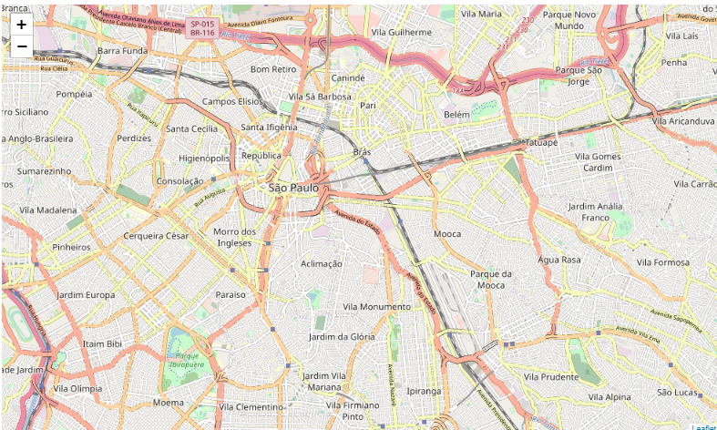
Methodology
Sao Paulo latitude and longitude found using geopy.
Created map of Sao Paulo using folium

Slide 5
Methodology
Higienopolis neighborhood was chosen for analysis.
Latitude and longitude for Higienopolis were found quickly using Google
Foursquare API used to retrieve top 5 venues until 500 meters around Higienopolis neighborhood

Slide 6
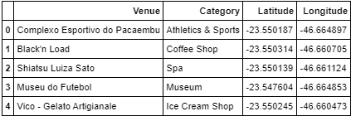
Results
The json was structured into a pandas dataframe with top 5 venues around Higienopolis

Slide 7
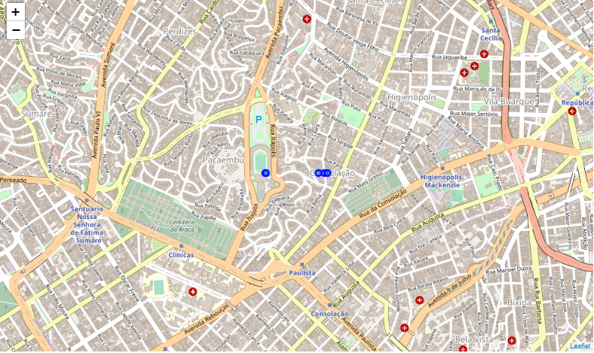
Results
A new map was created with zoom on Higienopolis and blue marks in the venues retrieved from Foursquare API

Slide 8
Conclusions/Discussion
The user can see what are the possibilities and the main venues in the neighborhood's surroundings
We have different venues categories in this data retrieved from Higienopolis, so we have a big variety of things to do around the Higienopolis neighborhood and it can be useful for people with different tastes

